Slide 1

App Control via Intune – Notes from the field
WDAC

Slide 2
Questions
Who uses WDAC in production? (not in a lab)
Who uses Applocker?
Third Party tooling for similar stuff?

Slide 3

Niels Kok
Consultant

Slide 4
Calendar
Introduction to WDAC
Configuration (Demo)
Tooling (Demo)
Challenges (Demo, Kinda)
Tips & Tricks (Demo, Kinda)

Slide 5
Introduction

Slide 6

App Control
Notes:
How do I make sure that I know what applications run on my Intune managed Windows devices?

Slide 7

Scope
Executable Files (.exe, .com)
Dynamic-Link Libraries (.dll, .ocx)
Scripts (.ps1, .vbs, .js, .cmd, .bat)
Installer Files (.msi, .msp, .mst)
Packages Apps (.appx, .msix, .appxbundle/.msixbundle)
Drivers (.sys)

Slide 8
Options for App Control
Applocker
App Control (WDAC)
Notes:
Only for Native options within Windows

Slide 9
Configuration (Demo)

Slide 10
Demo Content
Applocker
How to configure (via Intune)
Updating policies
App Control (WDAC)
How to configure (via Intune)
Updating policies
Notes:
Demo notes:

Slide 11
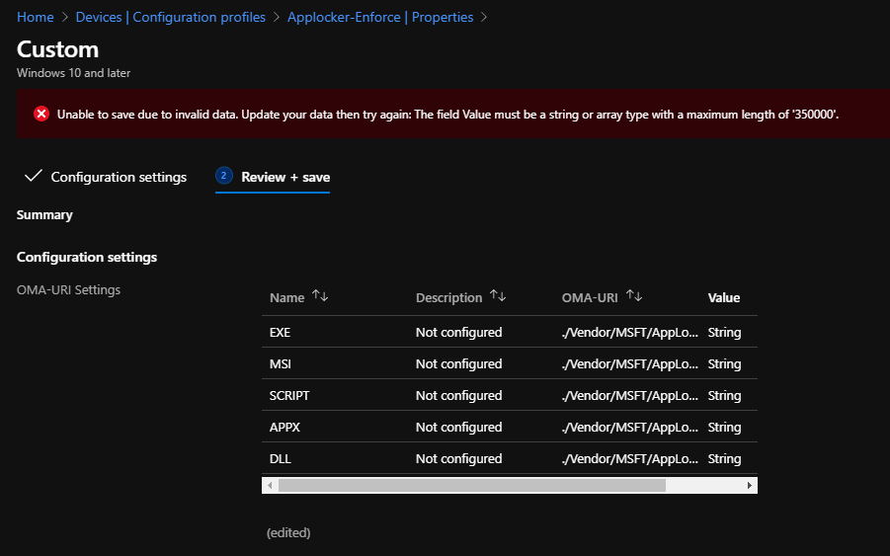
Max characters Applocker

Slide 12
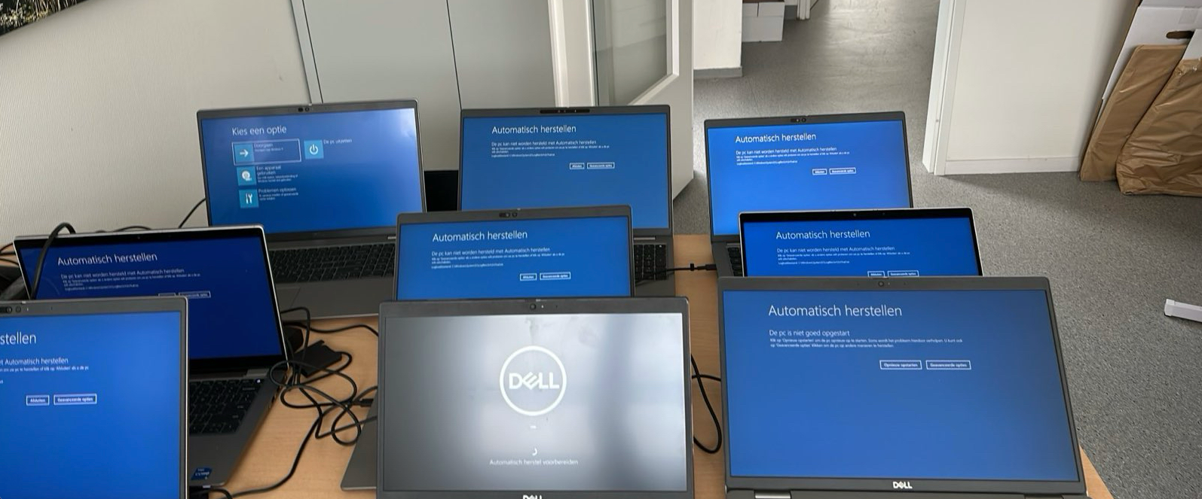
Driver blocklist failes – Blocklist Microsoft
Dell drivers

Slide 13
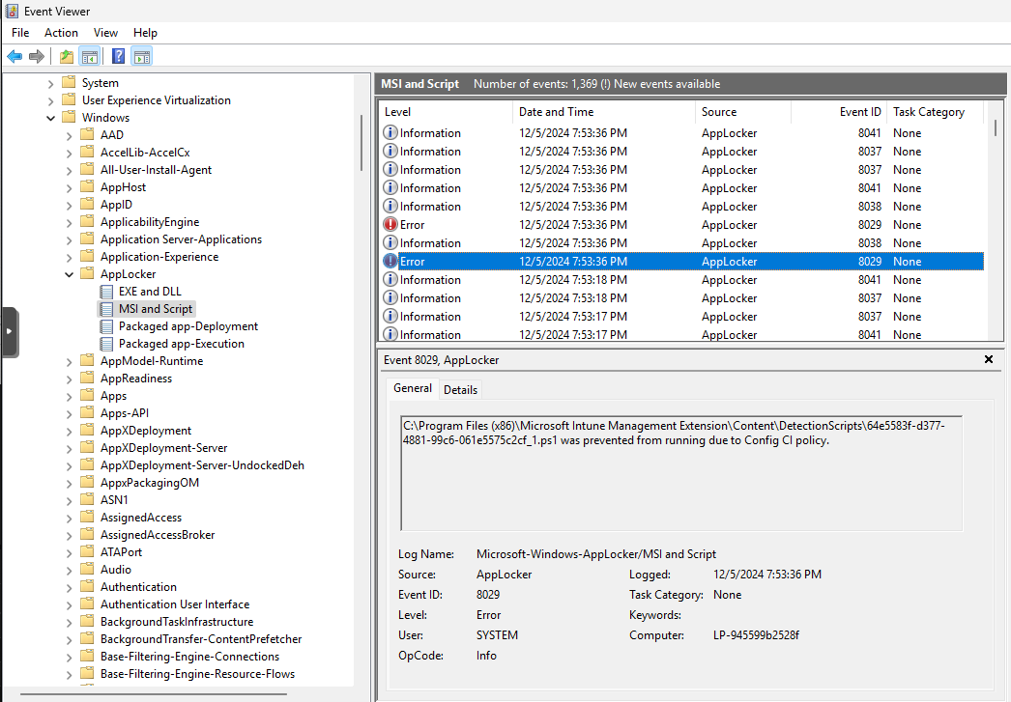
Forgot the managed installer

Slide 14
Store Applications
Block store via Intune is not enough

Slide 15
Challenges

Slide 16
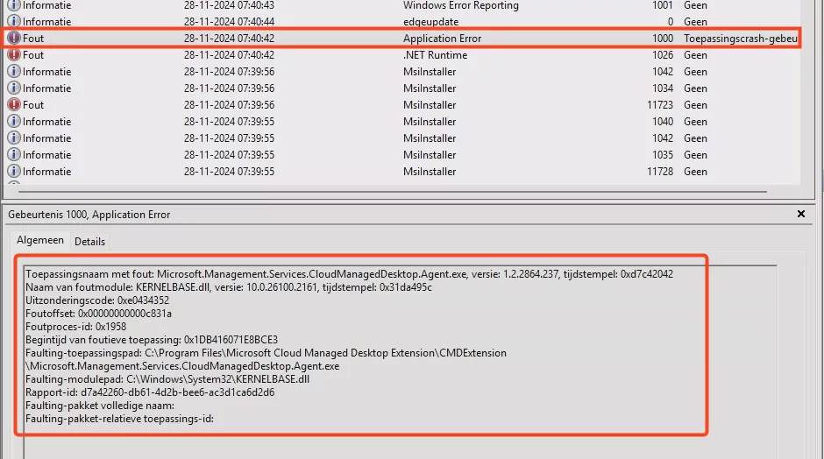
Windows 365

Slide 17
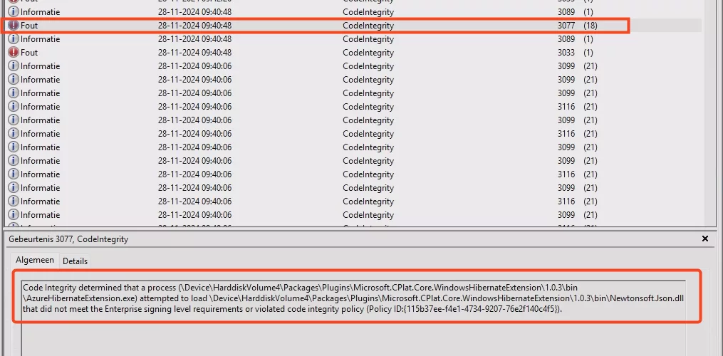

Slide 18
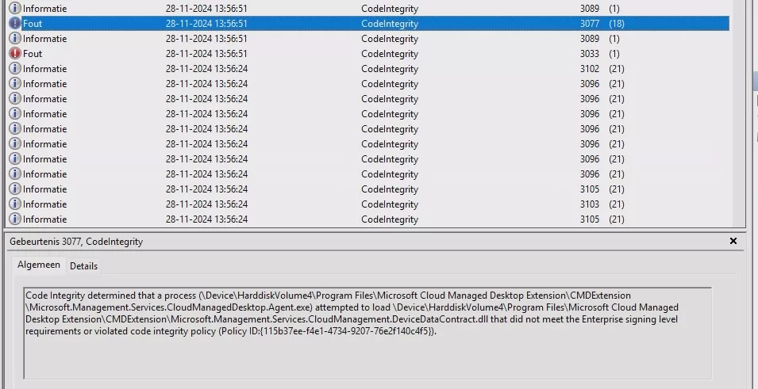

Slide 19
Microsoft Certificates
Microsoft Azure 3rd Party code sign
Microsoft Azure code sign

Slide 20
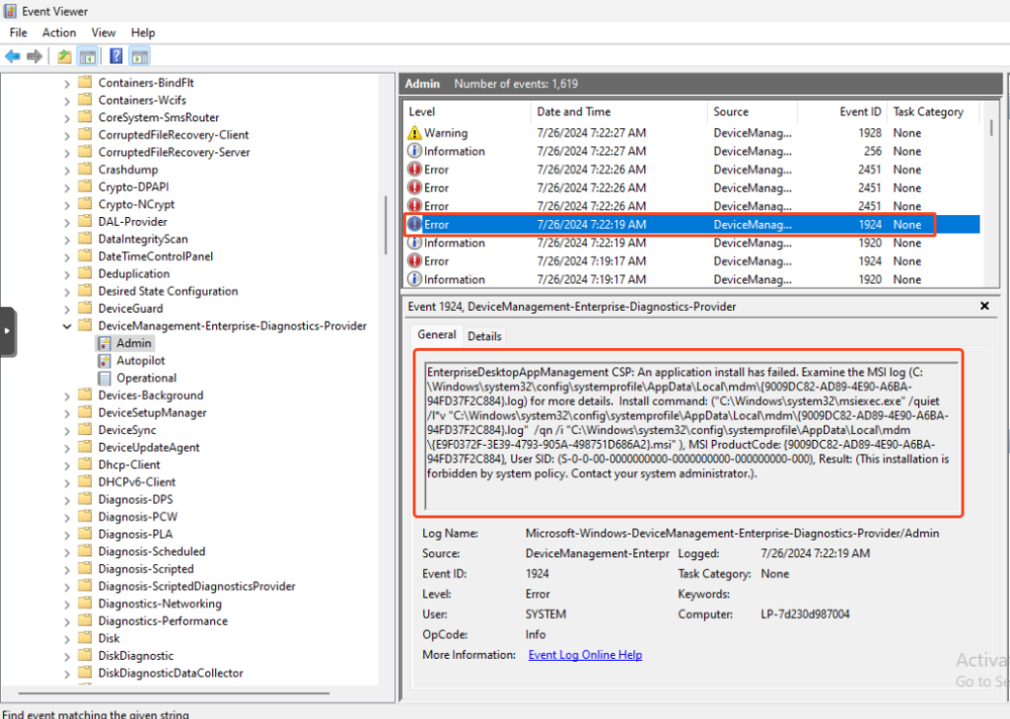
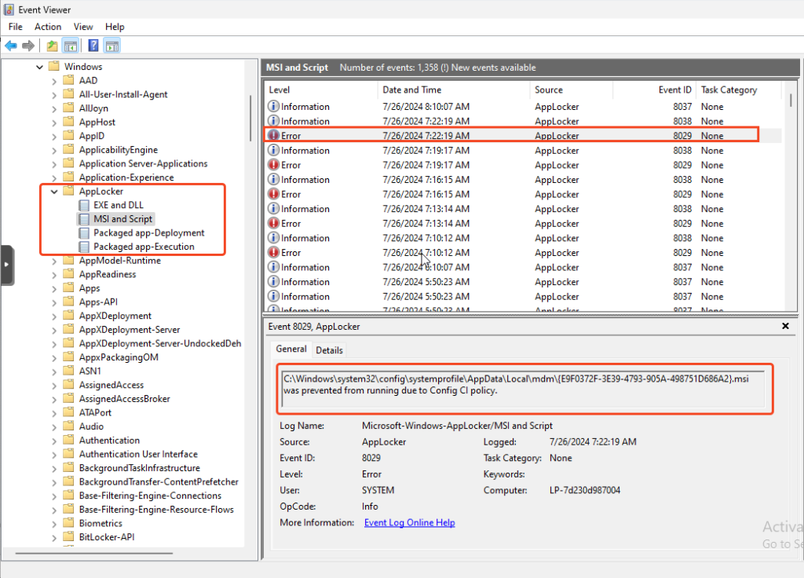
EPM

Slide 21
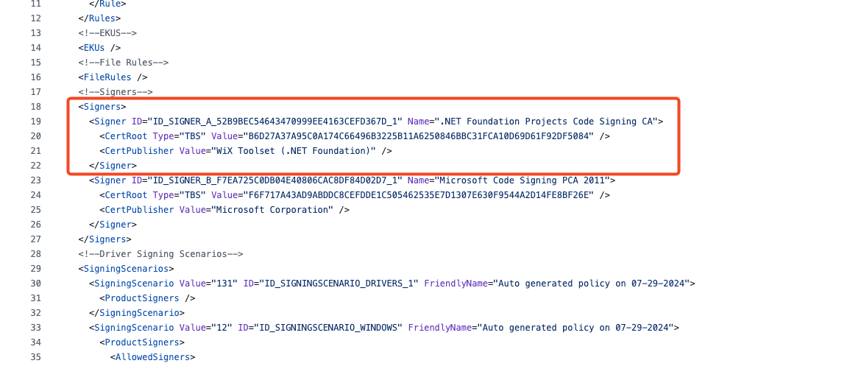

Slide 22
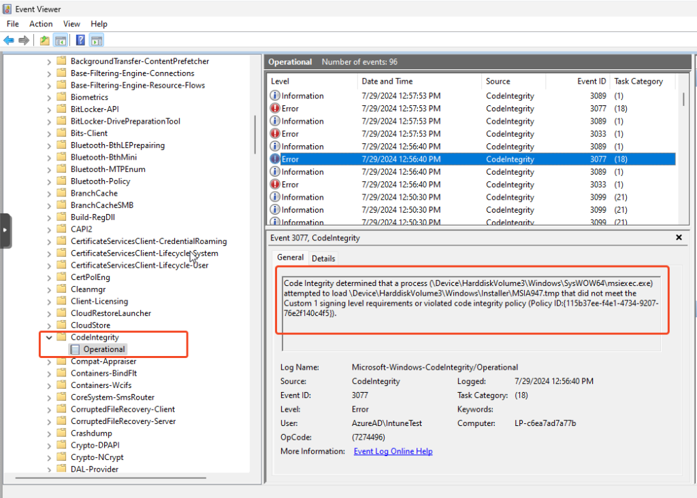
Teams Meeting Add-in

Slide 23



Blogpost QR codes
W365 blog
Teams Meeting Add-in
EPM

Slide 24


Slide 25


Slide 26


Slide 27
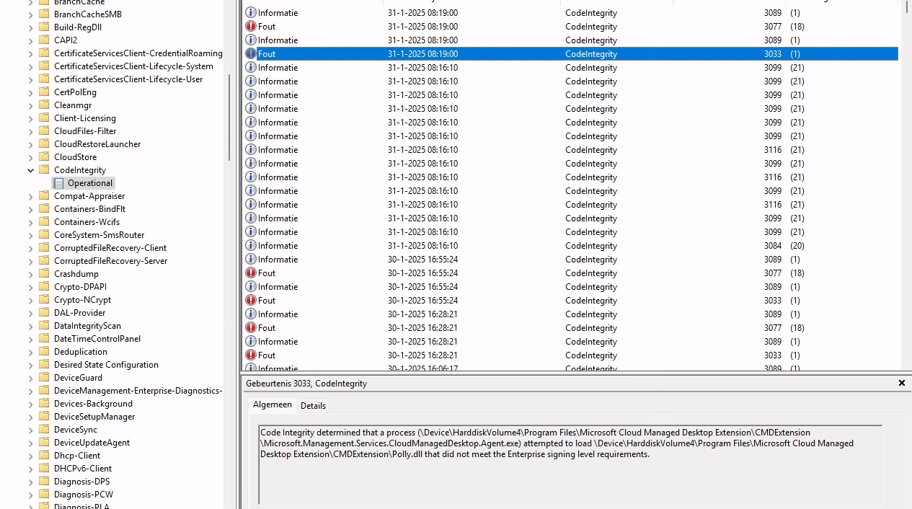
Cloud Managed Desktop Agent (Windows 365)

Slide 28
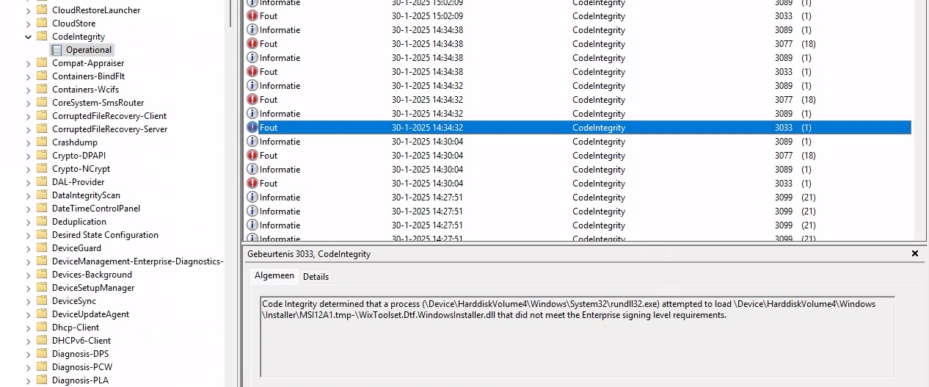
Probably EPM agent

Slide 29
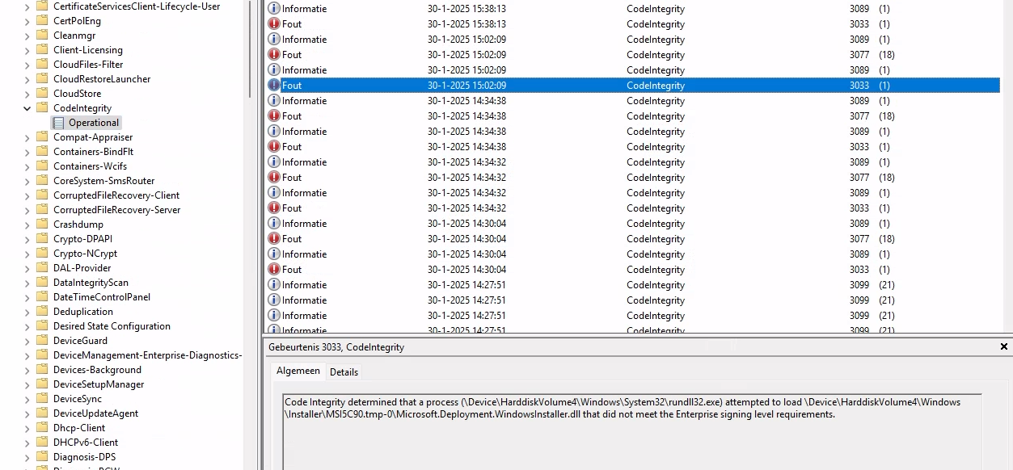

Slide 30


Slide 31
Tools

Slide 32
Tools
App Control Wizard
App Control Manager
Aaronlocker

Slide 33
Tips & Tricks

Slide 34
EventLogs
Applications and Services logs - Microsoft - Windows - CodeIntegrity - Verbose
Applications and Services logs - Microsoft - Windows - AppLocker - EXE and DLL
Applications and Services logs - Microsoft - Windows - AppLocker - Packaged app-Deployment
Applications and Services logs - Microsoft - Windows - AppLocker - Packaged app-Execution
Applications and Services logs - Microsoft - Windows - AppID - Operational
Applications and Services logs - Microsoft - Windows - CAPI2 - Operational
Applications and Services logs - Microsoft - Windows - DeviceGuard - Operational
Applications and Services logs - Microsoft - Windows - PowerShell - *
Windows - Application
Windows - System

Slide 35
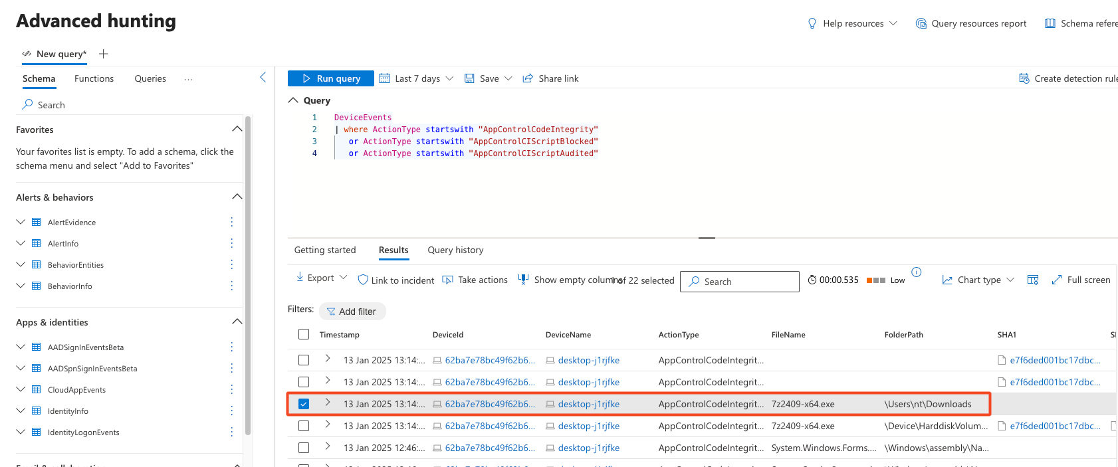
Defender for Endpoint

Slide 36
ManagedInstaller on AVD

Slide 37


Conclusion/Questions

